Slide 1
Blood Typing

Slide 2
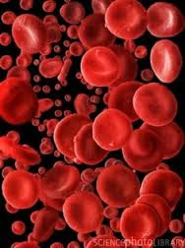
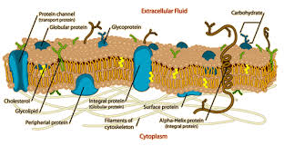
Blood typing is a method to tell what specific type of blood you have.
What type you have depends on whether or not there are certain proteins, called antigens, on the cell membranes of your red blood cells.

Slide 3
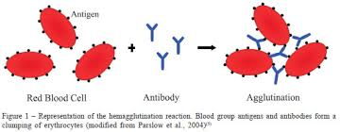
Human blood groups
  RBC membranes bear many different antigens
    Antigen: anything perceived as foreign that can generate an immune response
    RBC antigens are referred to as agglutinogens because they promote agglutination

Slide 4
  Human Blood Groups
  Humans have at least 30 naturally occurring RBC antigens.
  Presence or absence of each antigen is used to classify blood cells into different groups.
  Some blood groups (MNS, Duffy, Kell, and Lewis) are only weak agglutinogens
    Not usually typed unless patient will need several transfusions

Slide 5
ABO blood typing system
  Antigens of ABO and Rh blood groups cause most vigorous transfusion reactions; therefore, they are major groups typed
This method breaks blood types down into four types:
Type A
Type B
Type AB
Type O
Your blood type (or blood group) depends on the types that are been passed down to you from your parents.

Slide 6
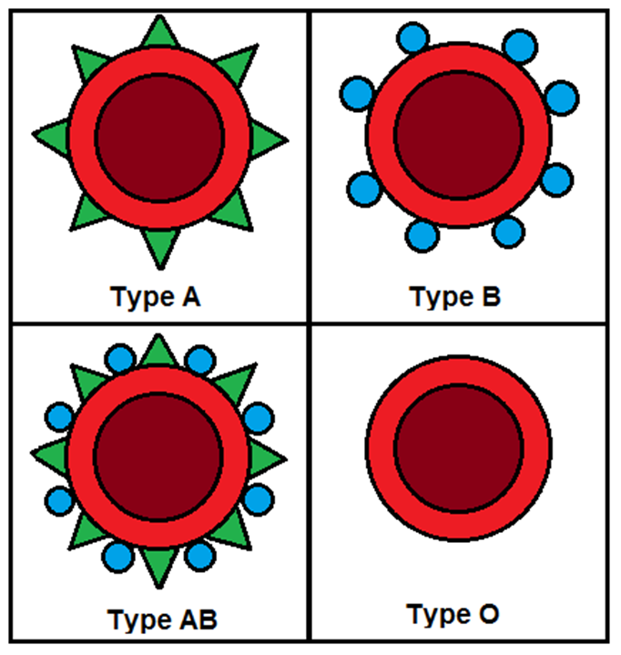
ABO Blood Group System
Blood groups determined by the presence or absence of two antigens – A and B – on the surface of red blood cells:

Slide 7
ABO Blood Group System
Group A – has only the A antigen on red cells (and B antibody in the plasma)
Group B – has only the B antigen on red cells (and A antibody in the plasma)

Slide 8
ABO Blood Group System
Group AB – has both A and B antigens on red cells (but neither A nor B antibody in the plasma)
Group O – has neither A nor B antigens on red cells (but both A and B antibody are in the plasma

Slide 9

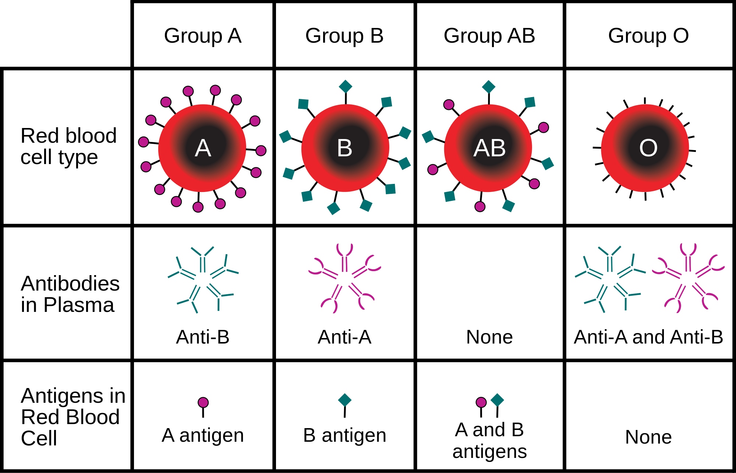

Slide 10
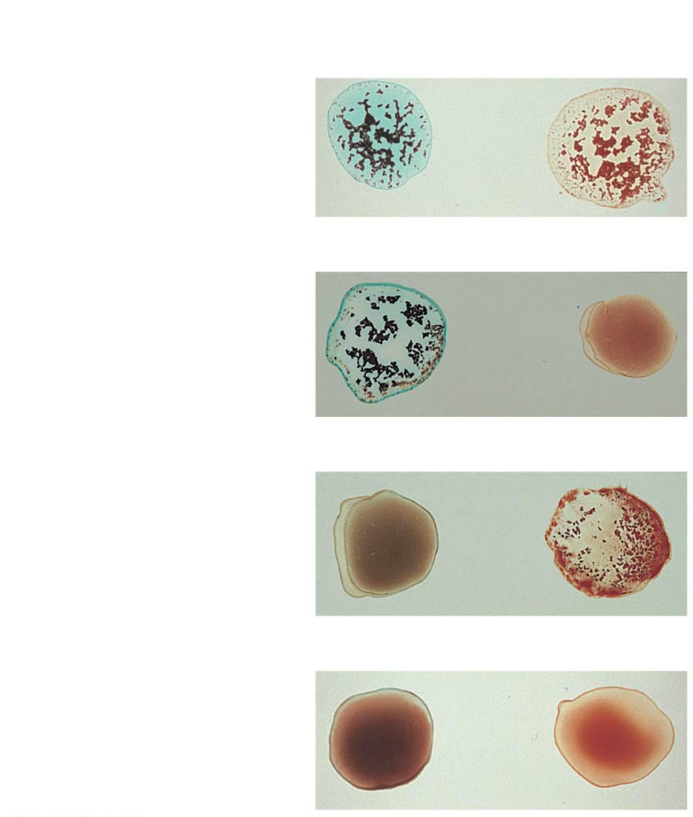
Blood being
tested
Serum
Anti-A
Anti-B
Type AB (contains
agglutinogens A and B;
agglutinates with both
sera)
RBCs
Type A (contains
agglutinogen A;
agglutinates with anti-A)
Type B (contains
agglutinogen B;
agglutinates with anti-B)
Type O (contains no
agglutinogens; does not
agglutinate with either
serum)

Slide 11
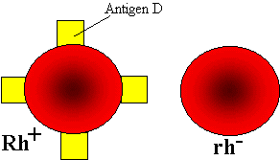
In addition to the A and B antigens, there is a third antigen called the Rh factor, which can be either present (+) or absent ( – ).
    Rh⁺ indicates presence of D antigen
      85% Americans are Rh⁺

Slide 12
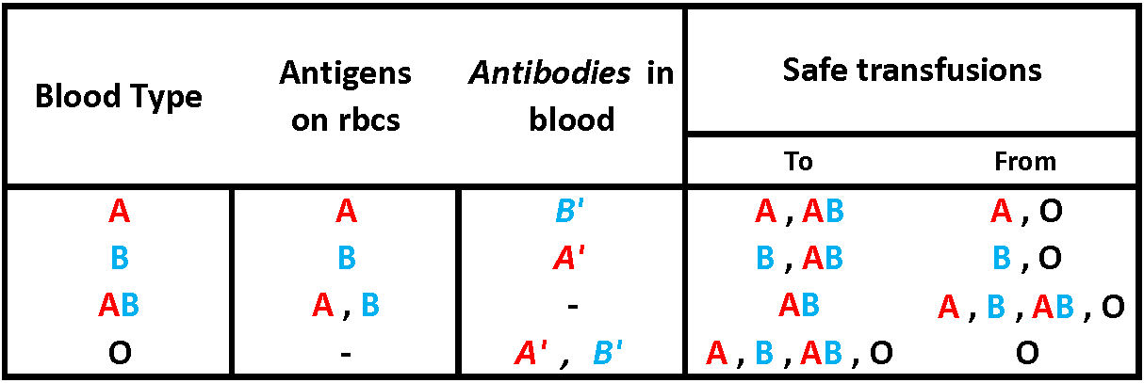

Slide 13
Blood typing game
https://www.nobelprize.org/educational/medicine/bloodtypinggame/

Slide 14
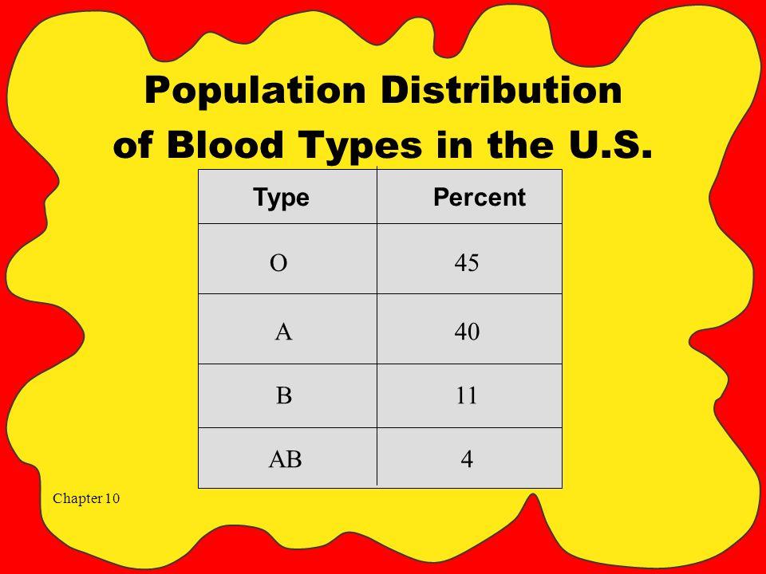
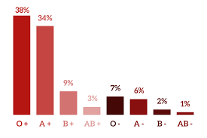

Slide 15
Why blood typing matters
(start at 2.22)
https://www.youtube.com/watch?v=xfZhb6lmxjk

