Slide 1
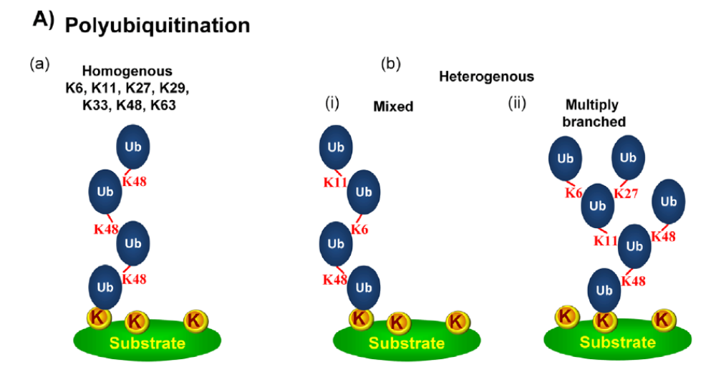

Slide 2
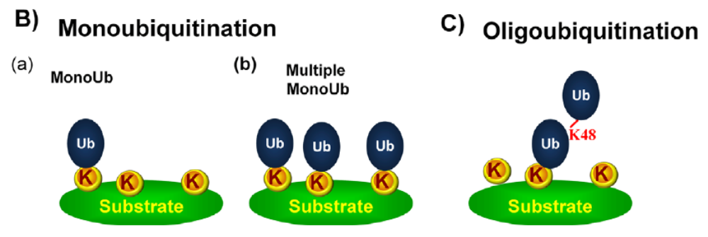

Slide 3
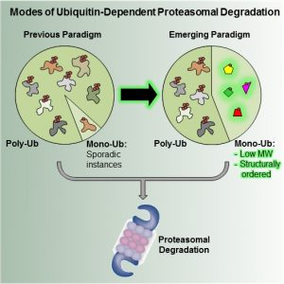

Slide 4
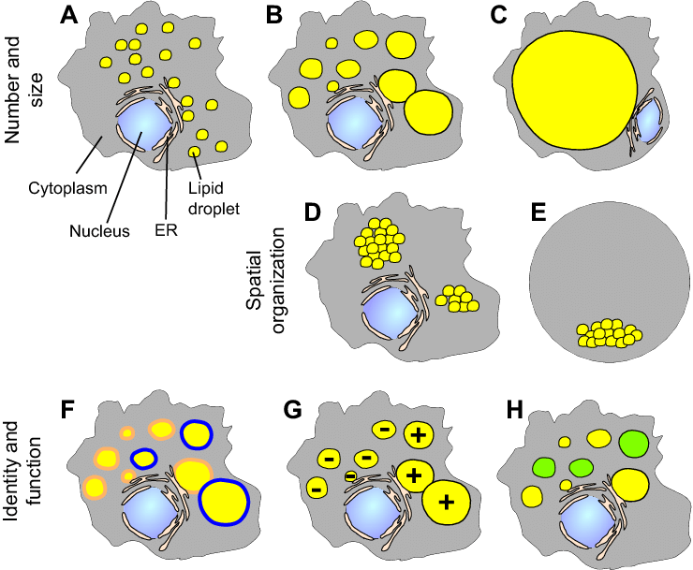
Many small LDs
A few medium-sized LDs
One large LD
Clustered LDs
Polarized LDs
Different protein associations
Some growing, others shrinking
Different lipid types

Slide 5
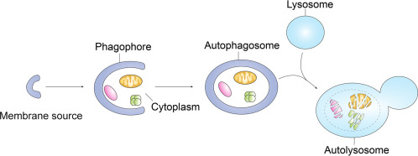

Slide 6
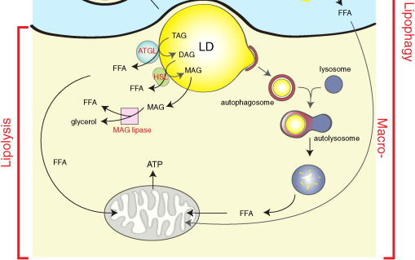

Slide 7
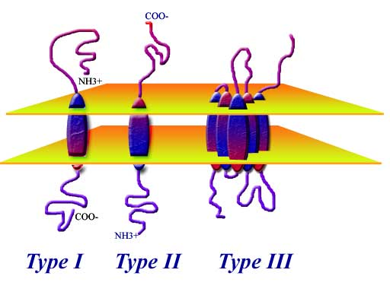
AUP1 (in today’s paper) is a type III membrane protein.

Slide 8
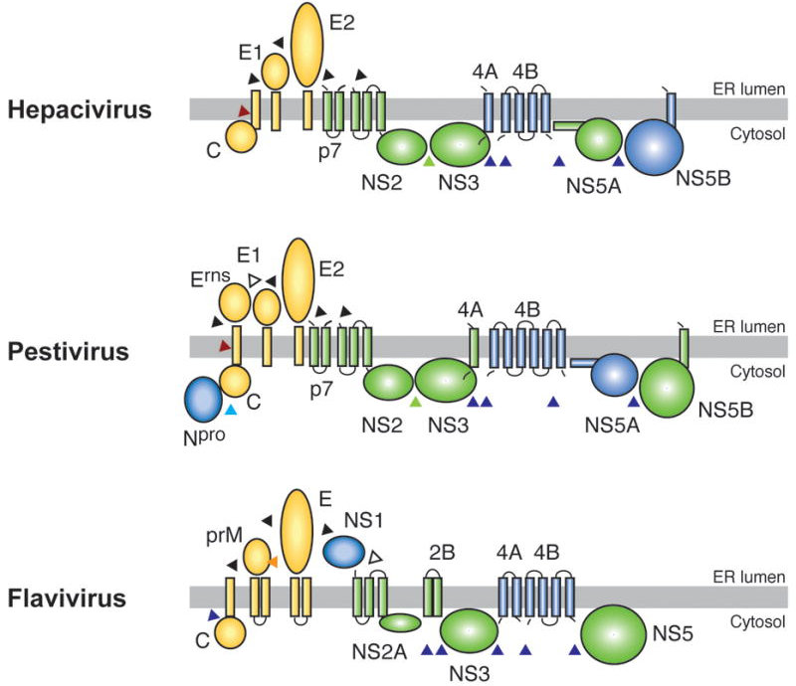
Nat Rev Microbiol. 2008 Sep; 6(9): 699–708.

